Slide 1
Compiler Construction
Muhammad awais ali
Department of Computer Science
university of management and technology

Slide 2
Review
So far, we’ve covered the following:
Compilation methods: compilation vs. interpretation.
The overall compilation process.
Front-end analysis
Lexical Analysis
Syntax Analysis
Semantic Analysis
Back-end analysis

Slide 3
Review
Lexical Analysis
Specify valid tokens with regular expressions.
Convert regular expression to a scanner which can recognize the valid tokens.
Use of automatic scanner generators like Lex.
Syntax Analysis
Specify valid patterns of tokens with context-free grammars.
Convert context-free grammar to a parser which can recognize valid strings in the language.
Use of automatic parser generators like Yacc.
Semantics Analysis
semantic analysis verifies the portion of the language definition which cannot feasibly be described by a context-free grammar.

Slide 4
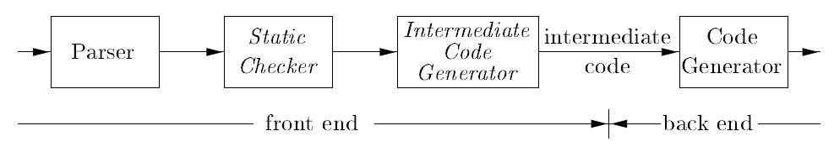
Intermediate Code Generation
In the analysis-synthesis model of a compiler, the front end analyzes a source program and creates an intermediate representation, from which the back end generates target code.
Static checking includes type checking, which ensures that operators are applied to compatible operands.

Slide 5

Intermediate Code Generation
It also includes any syntactic checks that remain after parsing. For example, static checking assures that a break-statement in C is enclosed within a while-, for-, or switch-statement; an error is reported if such an enclosing statement does not exist.
High-level representations are close to the source language and low-level representations are close to the target machine.
Syntax trees are high level; they depict the natural hierarchical structure of the source program and are well suited to tasks like static type checking.

Slide 6
Directed Acyclic Graph
Like the syntax tree for an expression, a DAG has leaves corresponding to atomic operands and interior codes corresponding to operators.
The difference is that a node N in a DAG has more than one parent
Directed Acyclic Graph (DAG) for the expression a + a * (b-c) + (b-c) * d
The leaf for a has two parents, because a appears twice in the expression. More interestingly, the two occurrences of the common subexpression b-c are represented by one node, the node labeled -. That node has two parents,

Slide 7
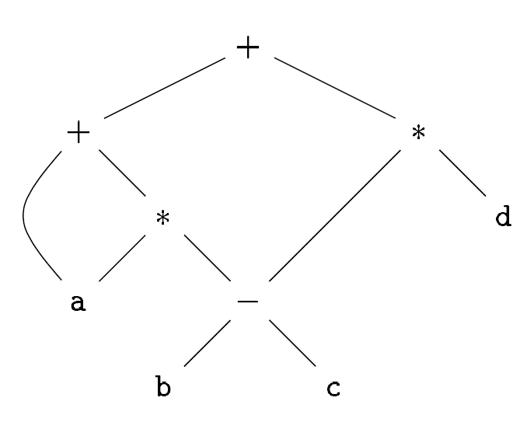
Directed Acyclic Graph - Example
Directed Acyclic Graph (DAG) for the expression a + a * (b-c) + (b-c) * d

Slide 8
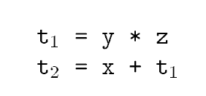
Three Address Code
In three-address code, there is at most one operator on the right side of an instruction
A source-language expression like x + y * z might be translated into the sequence of three-address instructions
where t₁ and t₂ are compiler-generated temporary names.

Slide 9
Three Address Code - Example
This unraveling of multi-operator arithmetic expressions and of nested flow-of-control statements makes three-address code desirable for target-code generation and optimization
Three-address code is a linearized representation of a syntax tree or DAG in which explicit names correspond to the interior nodes of the graph
Three Address Code (TAC) for the expression a + a * (b-c) + (b-c) * d

Slide 10
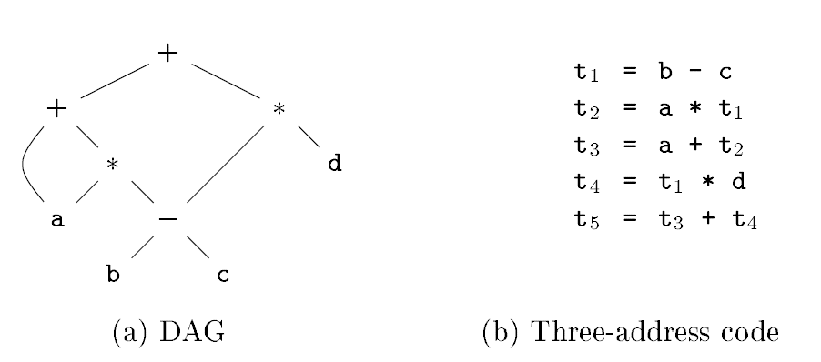
Three Address Code - Example
Three address code for the expression a + a * (b-c) + (b-c) * d

Slide 11
TAC - Address and Instruction
Three-address code is built from two concepts: addresses and instructions
Alternatively, three-address code can be implemented using records with fields for the addresses; records called quadruples and triples

Slide 12
TAC - Address and Instruction
An address can be one of the following:
A name: For convenience, we allow source-program names to appear as addresses in three-address code.
A constant: In practice, a compiler must deal with many different types of constants and variables.
A compiler-generated temporary: It is useful, especially in optimizing compilers, to create a distinct name each time a temporary is needed. These temporaries can be combined, if possible, when registers are allocated to variables.

Slide 13
TAC – Three Address Instruction Forms
List of the common three-address instruction forms
Assignment instructions of the form x = y op z, where op is a binary arithmetic or logical operation, and x, y, and z are addresses
Assignments of the form x = op y, where op is a unary operation. Essential unary operations include unary minus, logical negation
Copy instructions of the form x = y, where x is assigned the value of y.
An unconditional jump goto L. The three-address instruction with label L is the next to be executed.
Conditional jumps such as if x relop y goto L, which apply a relational operator (<, ==, >=, etc.) to x and y, and execute the instruction with label L

Slide 14
TAC – Three Address Instruction Forms
Procedure calls and returns are implemented using the following instructions:
Param x1
Param x2
Param x_{n}
Call p,n
generated as part of a call of the procedure p(xl,x2,. . . ,x_{n}). The integer n, indicating the number of actual parameters in "call p, n,“
Indexed copy instructions of the form x = y [i] and x [i] = y.
Address and pointer assignments of the form x = & y, x = * y, and * x = y

Slide 15
Three Address Code
Three such representations are called "quadruples”, "triples”, and "indirect triples“.

Slide 16
Quadruples
A quadruple (or just "quad') has four fields, which we call op, arg1, arg2, and result.
The op field contains an internal code for the operator.
For instance, the three-address instruction x = y + z is represented by placing + in op, y in arg1, z in arg2, and x in result.

Slide 17
Quadruples - Rules
The following are some exceptions to this rule:
Instructions with unary operators like x = minus y or x = y do not use arg2. Note that for a copy statement like x = y, op is =, while for most other operations, the assignment operator is implied.
Conditional and unconditional jumps put the target label in result.

Slide 18
Quadruples - Examples
Three-address code for the assignment
a = b * - c + b * - c ;
The special operator minus is used to distinguish the unary minus operator, as in - c, from the binary minus operator, as in b - c.

Slide 19
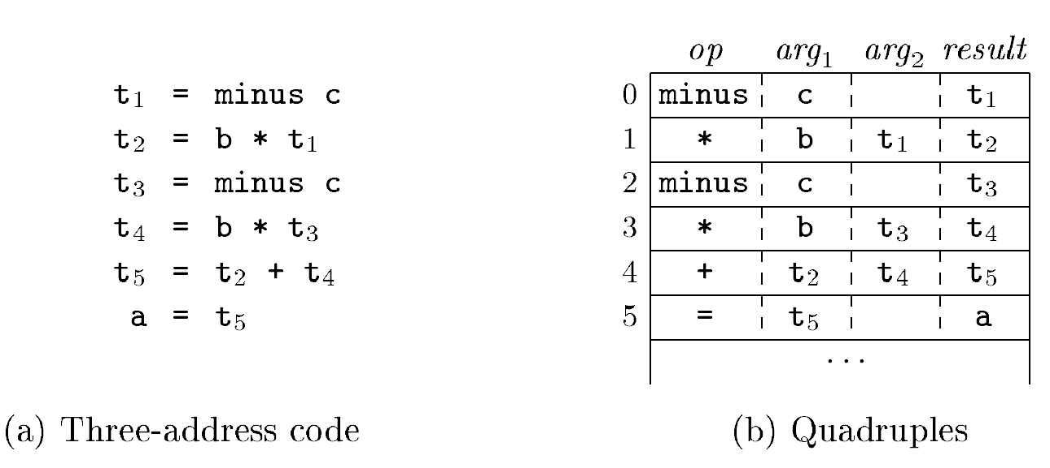
Quadruples - Examples
Three-address code and Quadruples for the assignment
a = b * - c + b * - c ;

Slide 20
Triples
A triple has only three fields, which we call op, arg1, and arg2.
Note that the result of quadruples is used primarily for temporary names. Using triples, we refer to the result of an operation x op y by its position, rather than by an explicit temporary name.
Thus, instead of the temporary t1 in quadruples, a triple representation would refer to position (0).

Slide 21
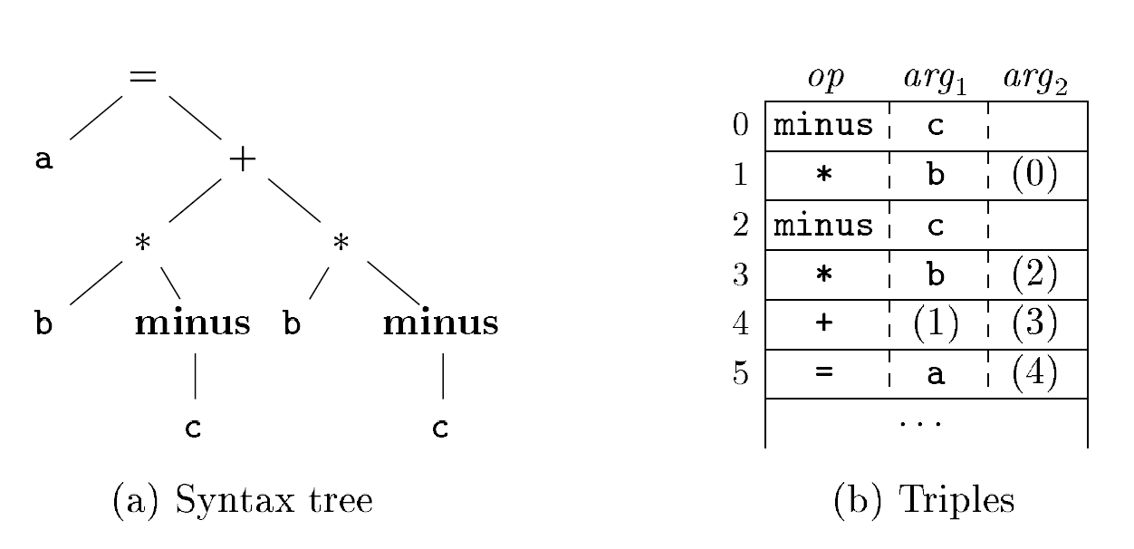
Triples - Examples
The syntax tree and triples of expression a = b * - c + b * - c ;

Slide 22
Indirect Triples
Indirect triples consist of a listing of pointers to triples rather than a listing of triples themselves
With indirect triples, an optimizing compiler can move an instruction by reordering the instruction list, without affecting the triples themselves.

Slide 23
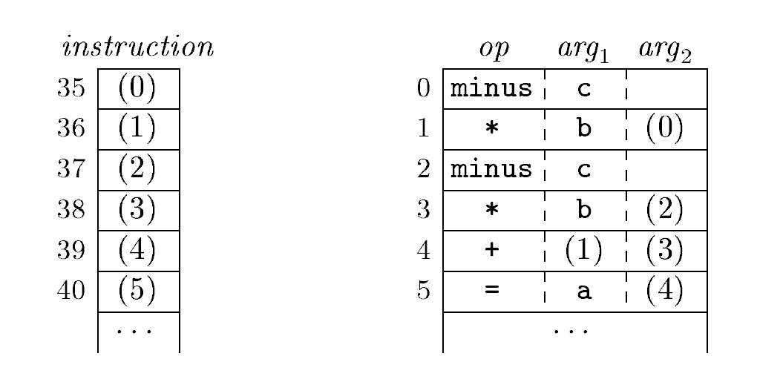
Indirect Triples - Examples
Indirect triples representation of three-address code

